Slide 1

K.RAMAKRISHNAN COLLEGE OF TECHNOLOGY
DEPARTMENT OF ARTIFICIAL INTELLIGENCE
B.Tech (AI&ML)
20AM6203-DESIGN PROJECT - 2
BATCH NO: 5
Guided by: Mr.A.Joshua Issac AP/AI
BATCH MEMBERS
ARCHANA R S 811722001003
KAVITHA A 811722001023 THAMILARASI B 811722001051
SIVA RANJANI S 811722001501

Slide 2

CUSTOM OUTFIT GENERATOR WITH VIRTUAL TRY-ON

Slide 3
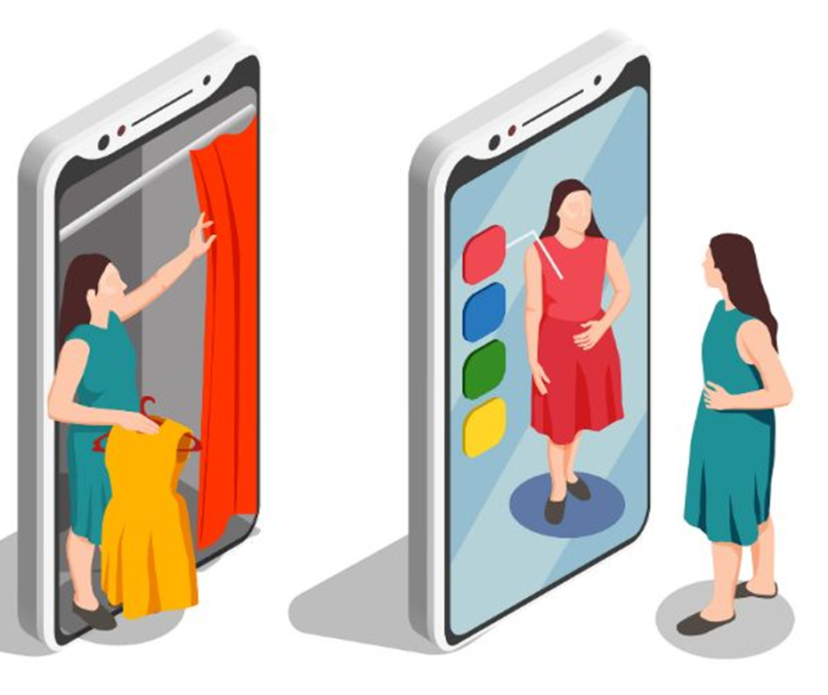
OBJECTIVE:
To develop an AI-based system that allows users to generate and visualize custom outfits in real-time using webcam images or uploaded photos.

Slide 4
EXISTING SYSTEM
Traditional systems like VITON and TryOnGAN depend on pre-scanned garments and limited clothing templates.
Demerits
Lack of real-time processing.
Dependency on predefined clothing templates.
Difficulty in handling complex poses.
Limited style customization.

Slide 5
PROPOSED SYSTEM
A real-time outfit generation and try-on system using:
Stable Diffusion with ControlNet for text-to-outfit synthesis.
MediaPipe for pose estimation.
Gradio UI for user interaction.
Webcam or image upload to capture user pose.
Users can input gender and style prompts (e.g., "red hoodie with denim jeans").
Generated outfits are displayed in real-time with an option to save.

Slide 6
LITERATURE SURVEY
S.NO | TITLE | AUTHOR | YEAR | TECHNIQUES & TOOLS | MERITS | DEMERITS
1 | OutfitAnyone: Ultra-high Quality Virtual Try-On for Any Clothing | Ke Sun, Jian Cao, Qi Wang, Linrui Tian | 2024 | Two-stream diffusion model | High-fidelity, scalable, diverse poses | Control-consistency balance issue
2 | FashionSD-X: Multimodal Fashion Garment Synthesis using Latent Diffusion | Abhishek Kumar Singh, Ioannis Patras | 2024 | Latent diffusion, ControlNet, LoRA | Multimodal Input Integration, Enhanced Performance, Dataset Augmentation | Sketch Dependency, Data Diversity Limitations
3 | MMTryon: Multi-Modal Multi-Reference Control for High-Quality Fashion Generation | Xujie Zhang, Yuxuan Luo, Michael Kampffmeyer | 2024 | Multi-modal attention, parsing-free | High Customization, Visual Fidelity, Flexible Input Handling | Training Complexity, Fashion Limitations
4 | Fashion-VDM: Video Diffusion Model for Virtual Try-On | Rajesh Kumar Butteddi, Srija Butteddi | 2024 | Video diffusion model, split-CFG | Realistic Output, Personalized Experience, Enhanced User Engagement | High Computational Cost, Limited Garment Diversity
5 | DressCode: Text-Guided Garment Generation | Kai He, Kaixin Yao, Qixuan Zhang, Jingyi Yu | 2024 | Autoregressive model | Fine control, text-based design | Slow, less scalable

Slide 7
FLOW DIAGRAM
User uploads/captures image.
Pose Estimation using MediaPipe
Input Text Prompt & Style Selection.
Output Displayed in UI (Try-On)
Outfit Image Generated
Pose + Prompt Sent to Stable Diffusion + ControlNet
End

Slide 8
SYSTEM & SOFTWARE SPECIFICATIONS
Hardware: | Software:
Intel Core i5/i7 Minimum 8GB RAM GPU (optional for faster generation) | Python 3.9+ Libraries: diffusers, torch, numpy, mediapipe, PIL, gradio Model Checkpoints: Stable Diffusion v1.5, ControlNet OpenPose, OpenCV

Slide 9
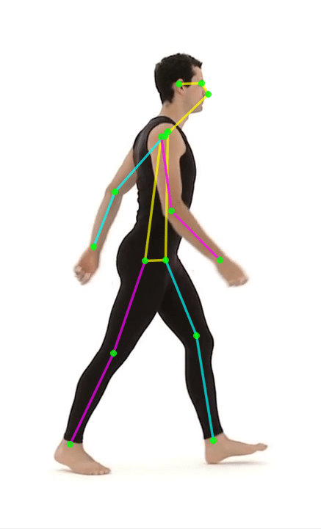
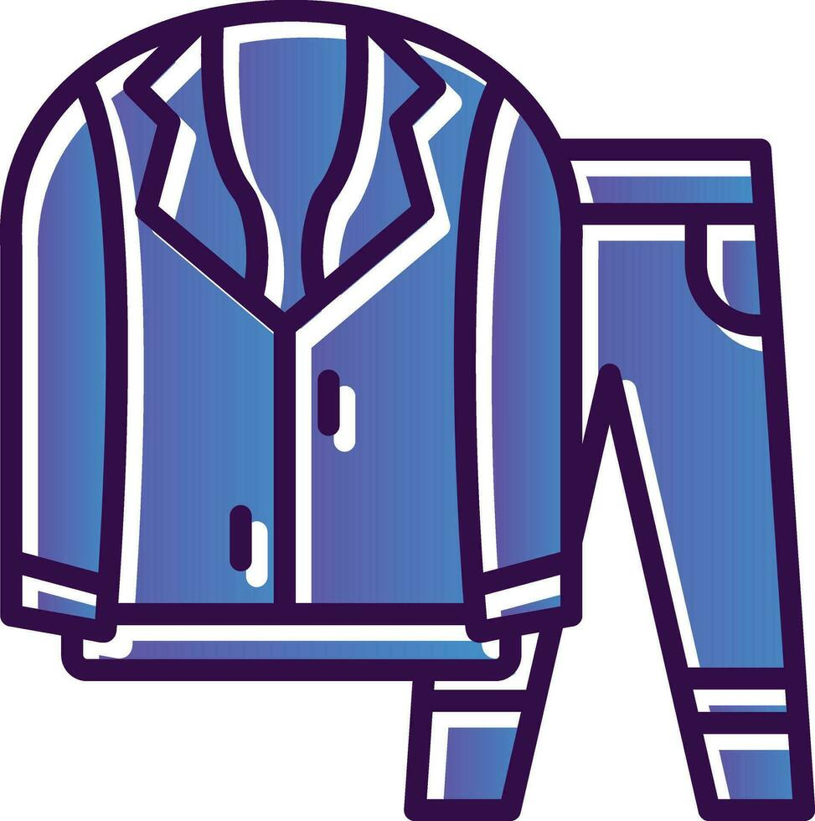

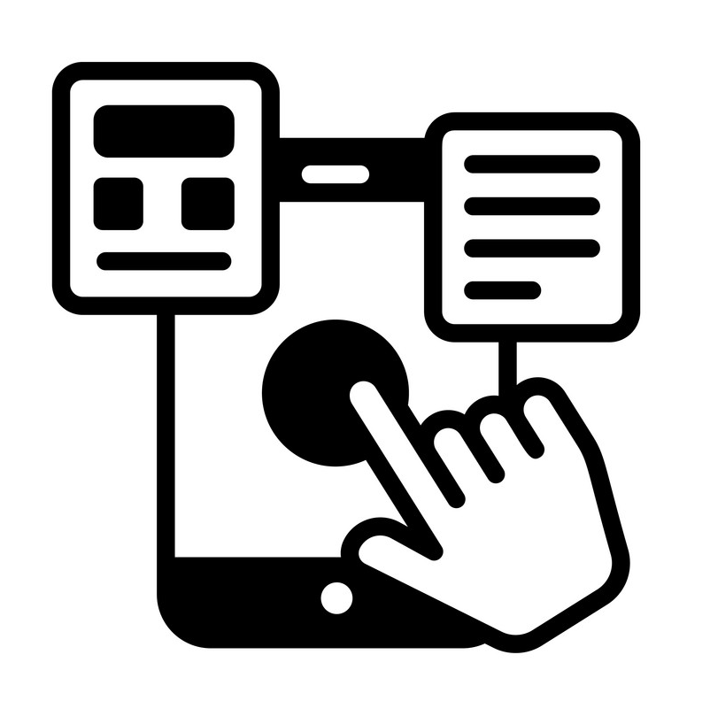
MODULES
1. Webcam/Image Capture Module
2. User Interaction Module
3. Pose Estimation Module
4. Outfit Generation Module

Slide 10
Module 1: Webcam/Image Capture
Functionality:
Captures real-time webcam feed or accepts uploaded image input.
Preprocesses input for pose extraction and generation.
Algorithm/Tools Used:
OpenCV: For real-time webcam interfacing and frame capture.
Pillow (PIL): For image resizing, format conversion, and loading.
NumPy: For image array manipulation.

Slide 11
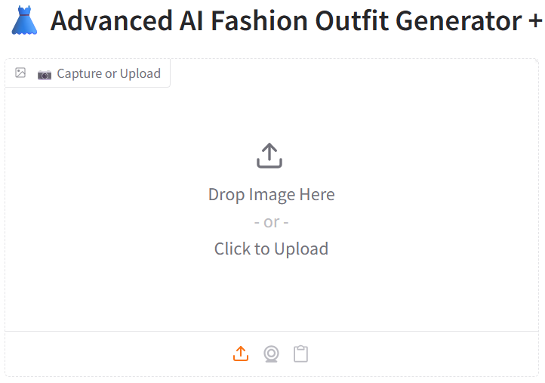
Workflow:
Capture image using webcam or upload.
Convert to required format (RGB/PIL).
Pass to Pose Estimation Module.

Slide 12
WORKING MECHANISM
Capture Input
Uses webcam or image upload.
Image Preprocessing
Resize, crop, and normalize image for consistent input.
Save & Forward
Stores image locally.
Sends to Pose Estimation (Module 3) and UI display.

Slide 13
Module 2: User Interaction
Functionality:
Collects user input like gender, clothing style, and outfit type.
Controls generation workflow (generate/save).
Algorithm/Tools Used:
Gradio UI Framework: For dropdowns (e.g., Male/Female, Outfit type).
For text prompts (style descriptions like "casual denim jacket").

Slide 14
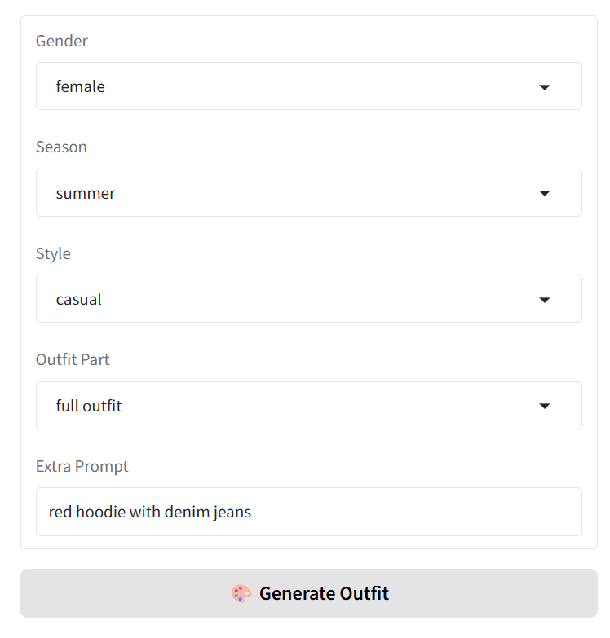
Workflow:
Prompt entry + selection via UI.
Combine inputs into a text conditioning prompt.
Trigger outfit generation.

Slide 15
WORKING MECHANISM
Collect Inputs
Text prompt (e.g., “red jacket”), gender, style.
Pose image from Module 3.
Prompt Structuring
Combine inputs into a full sentence for clarity: “A female model in red jacket, casual style”
Trigger Generation
Sends structured prompt + pose to Outfit Generation (Module 4).

Slide 16
Module 3: Pose Estimation
Functionality:
Extracts body pose from user image and converts it to skeleton format.
Provides structural guidance for image generation.
Algorithm Used:
MediaPipe Pose Estimation (by Google):
Lightweight model that predicts 33 body landmarks in real-time.
Based on BlazePose algorithm with heatmap regression.
Works using Convolutional Neural Networks (CNNs) optimized for speed.

Slide 17
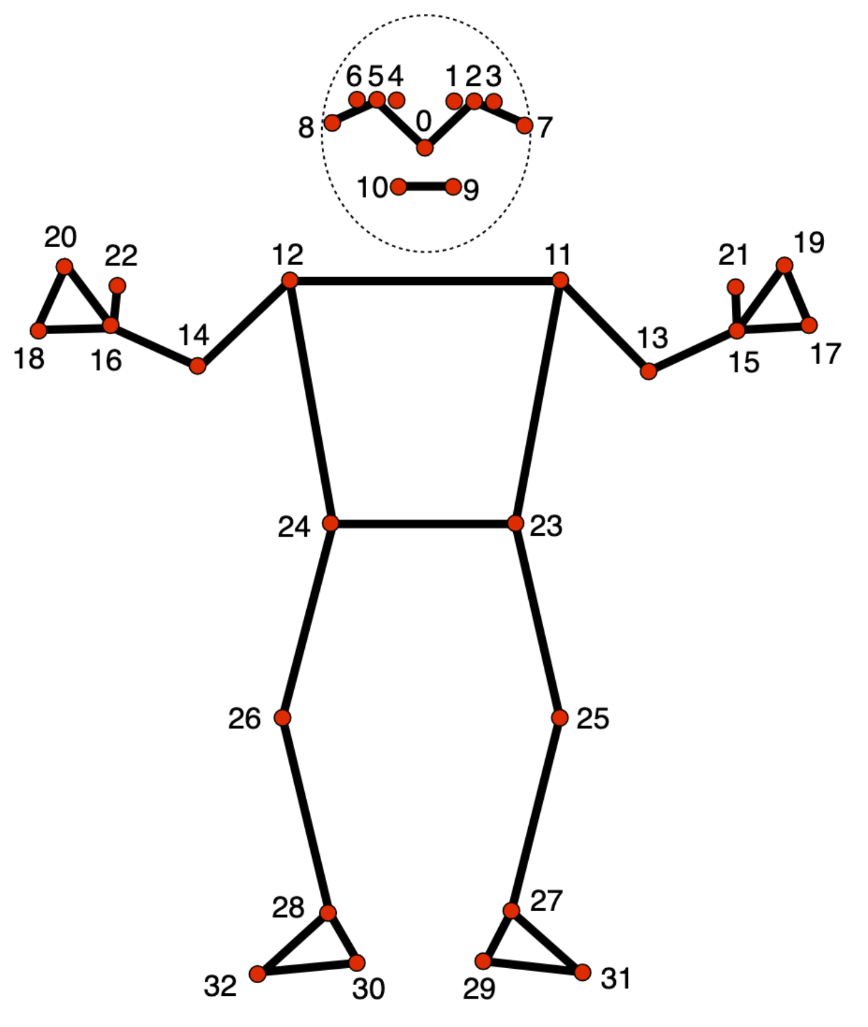
Output:
Generates a skeleton or keypoint map image used for conditioning the diffusion model (via ControlNet).
Why Used:
Ensures generated outfit aligns with user's body structure.
Enables pose-aware generation.

Slide 18
WORKING MECHANISM
Process Image
Resizes image to fit MediaPipe input.
Detect Landmarks
MediaPipe BlazePose finds 33 keypoints.
Draw Skeleton Map
OpenCV draws joints & lines for body structure.
Output: Skeleton image sent to ControlNet.

Slide 19
Module 4: Outfit Generation Module
Combines user prompt and pose image to condition Stable Diffusion.
Uses ControlNet with OpenPose for structure.
Outputs a photorealistic image of the user wearing generated clothing.
Functionality:
Generates a new outfit image using text prompt and pose as input.
Overlays or merges the outfit with original image.

Slide 20
Algorithms/Models Used:
Stable Diffusion:
A Latent Diffusion Model (LDM) that performs text-to-image generation.
Uses a VAE (Variational Autoencoder) + U-Net + CLIP text encoder.
ControlNet (OpenPose Condition):
Extends Stable Diffusion to accept additional conditions (pose images).
Controls spatial layout using user’s skeleton pose.

Slide 21
WORKING MECHANISM
Input Compilation
Takes prompt + pose image.
CLIP Embedding
Converts text to image-understandable format.
Generate Image
Stable Diffusion + ControlNet create outfit aligned with pose.
Virtual Try-On (Optional)
Merges outfit with user’s face/body using segmentation.

Slide 22
Inference Flow:
User prompt + gender → Tokenized using CLIP.
Skeleton image (from Pose Estimation) → Encoded as condition.
Stable Diffusion + ControlNet → Generates outfit image.
Result shown in UI and optionally saved.

Slide 23
ADVANTAGES
Real-time virtual try-on experience
Personalized outfit generation from text prompts
Accurate pose-based outfit fitting
High-quality and diverse fashion outputs
Simple and user-friendly Gradio interface
Supports gender and style variations
Easily upgradable and modular system
Built with free, open-source tools

Slide 24
APPLICATIONS
Online clothing retailers (Amazon, Myntra, etc.)
Virtual trial rooms in shopping apps
Fashion design and customization
Social media styling tools
Personalized fashion assistants
AR-based outfit previews
Gaming and virtual avatars
Costume planning and concept art

Slide 25
CONCLUSION
It presents a complete virtual try-on solution that combines the creativity of generative models with real-time pose estimation. It offers a novel way for users to visualize custom outfits quickly and interactively, opening doors to personalized fashion experiences and AI-aided apparel design.

Slide 26
REFERENCES
Bochinski, E., et al. (2022). "Pose-Guided Try-On using ControlNet." CVPR Workshops.
Han, X., et al. (2018). “VITON: An Image-Based Virtual Try-On Network.” CVPR.
Wang, B., et al. (2018). “Toward Characteristic-Preserving Image-Based Virtual Try-On Network.” ECCV.
Karras, T., et al. (2019). “A Style-Based Generator Architecture for GANs.” CVPR.
Hugging Face Diffusers - https://huggingface.co/docs/diffusers

Slide 27
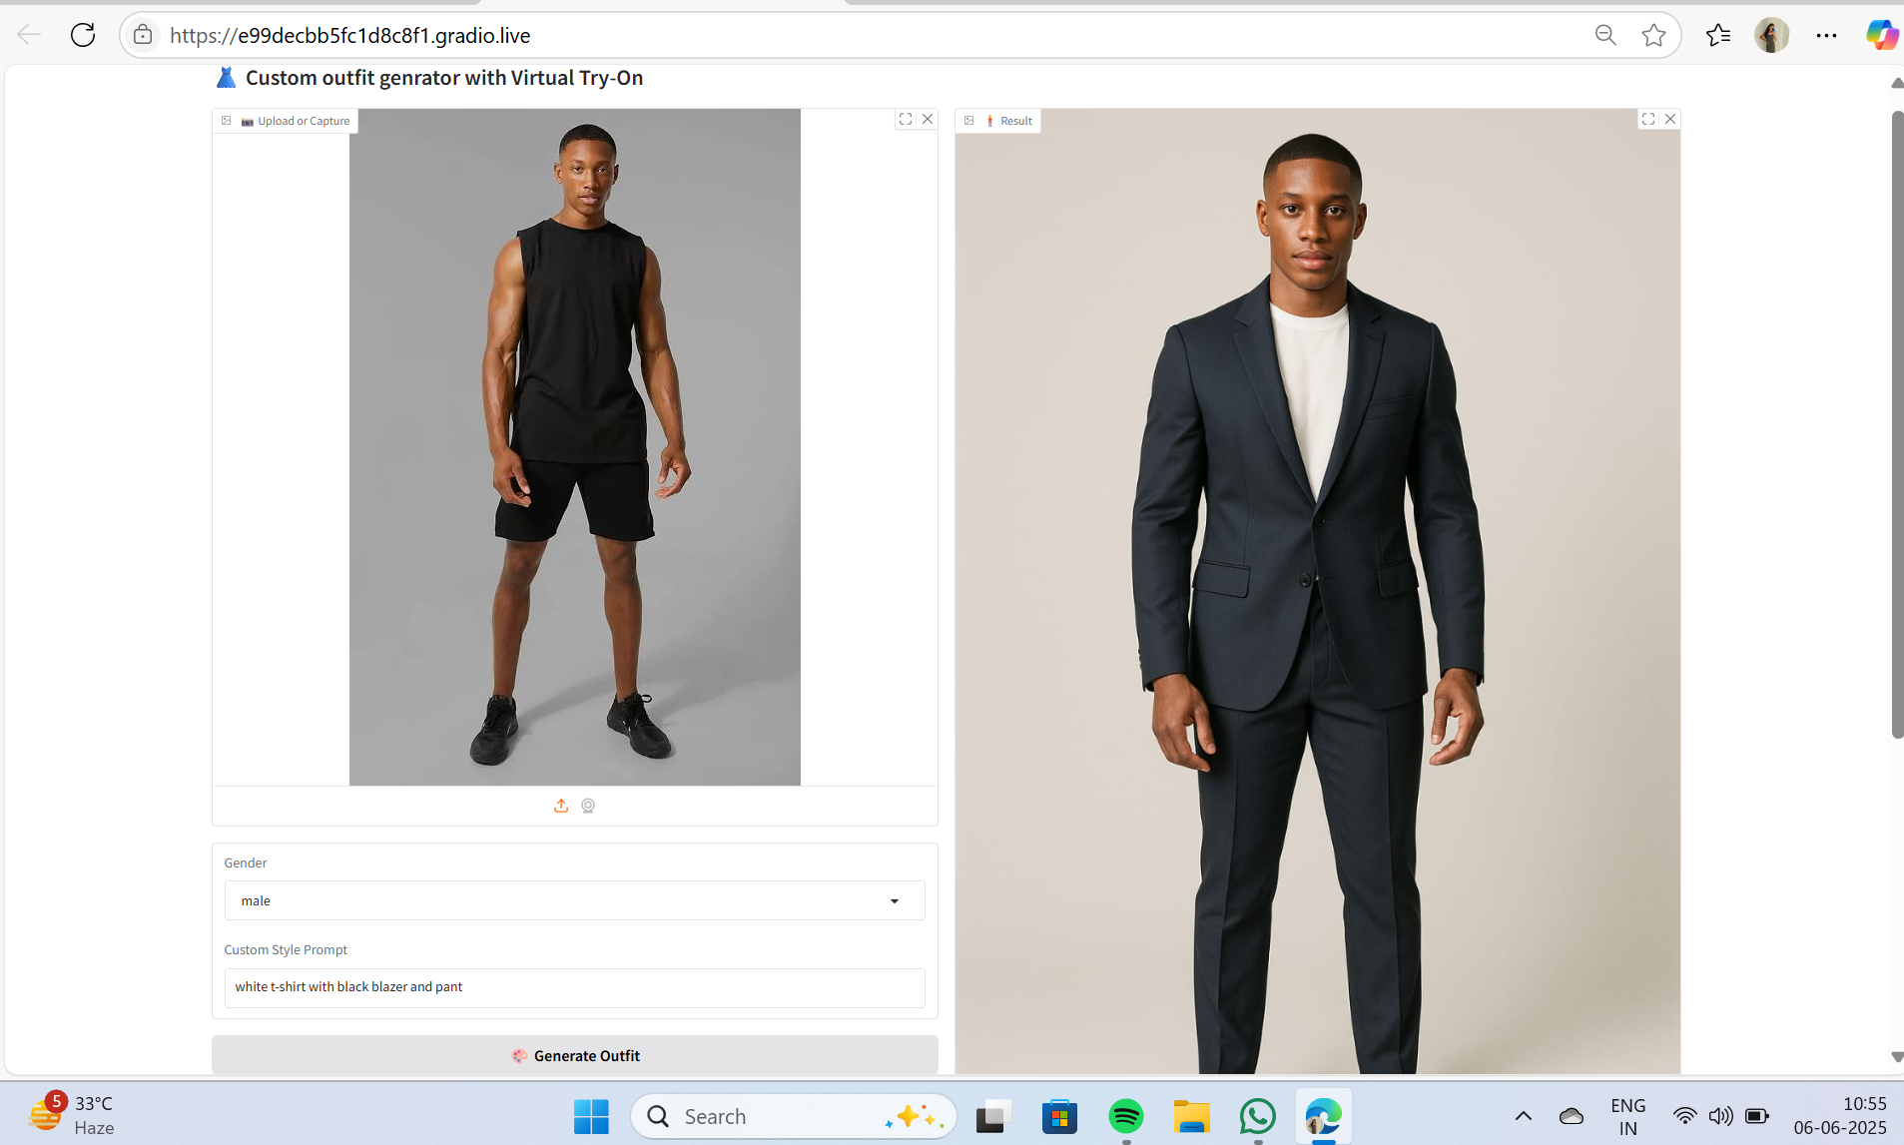
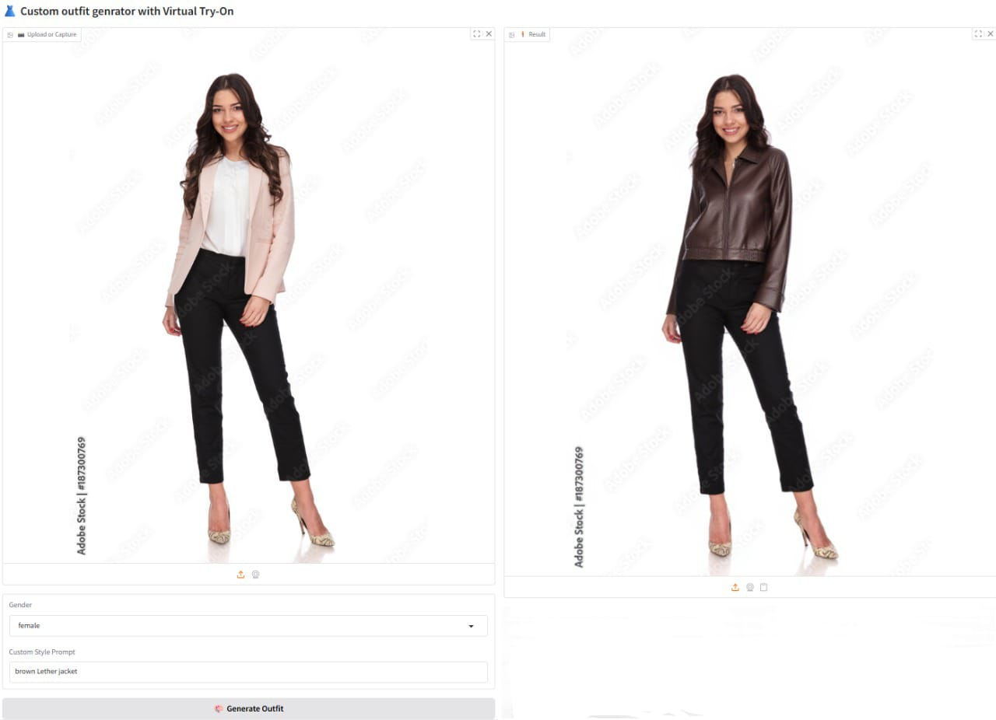
OUTPUTS

Slide 28
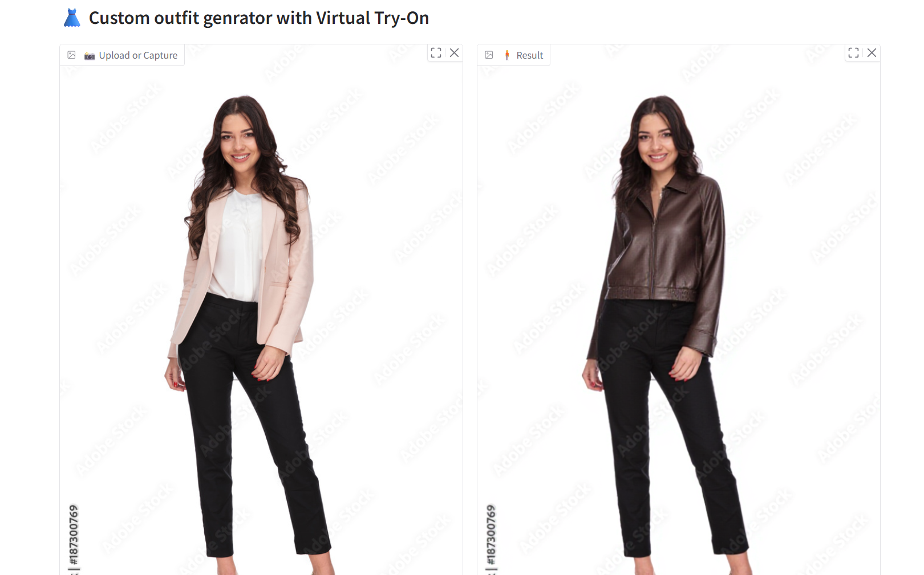

Slide 29
THANK YOU…

